Slide 1
Robust Decision Support Methods A Comparative Analysis
Erin Bartholomew

Slide 2
Agenda
What’s the Big Deal?
Research Goal
Method and Implementation
Results
Conclusions

Slide 3

UN Millennium Development Goals – 2000

Slide 4

















UN Sustainable Development Goals – 2015

Slide 5
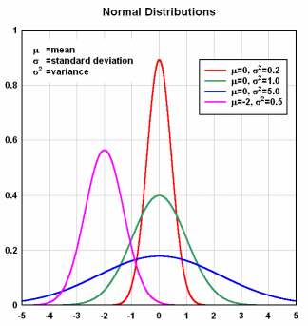

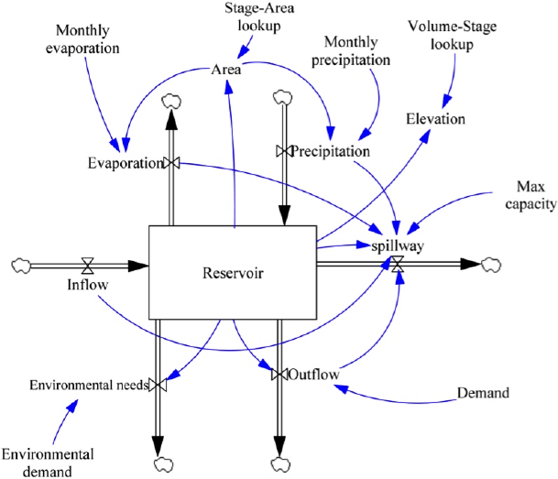
Deep Uncertainty
?
?
?
Models
Probabilities
Priority Ranking

Slide 6
Research Goal
What are the trade-offs between different methods of decision support when considering a wicked problems and varying policy implementation structures?
Development of comparative framework
Used to compare three methods, three variations of a deeply uncertain problem

Slide 7
Robust Decision Making
1. Model Specification
Structured 4-step decision support framework
Model Specification (XLRM)
Policy Levers (L)
External Uncertainties
(X)
System Relationships
(R)
Outcomes of Interest
(M)
Notes:
It’s out of the box MORDM based on Kasprzyk 2013. No fancy stuff going on. Reference scenario is from literature (Quinn 2017).

Slide 8
Robust Decision Making
1. Model Specification
Structured 4-step decision support framework
Model Specification
Policy Alternative Determination
2. Policy Alternative Determination
Notes:
It’s out of the box MORDM based on Kasprzyk 2013. No fancy stuff going on. Reference scenario is from literature (Quinn 2017).

Slide 9
Multi-Objective Evolutionary Algorithms
Iterative, seeking a set of policy alternatives
Determines membership to the final set through a customizable fitness test
Commonly used options: ε-NSGAII, Borg

Slide 10
Robust Decision Making
1. Model Specification
Structured 4-step decision support framework
Model Specification
Policy Alternative Determination
Computational Exploration
Scenario Discovery
2. Policy Alternative Determination
3. Computational Exploration
4. Scenario Discovery
Notes:
It’s out of the box MORDM based on Kasprzyk 2013. No fancy stuff going on. Reference scenario is from literature (Quinn 2017).

Slide 11
Multi-Objective Robust Decision Making
1. Model Specification
Introduced by Kasprzyk (2013) as an extension of RDM
Uses an MOEA to determine potentially robust policy alternatives
2. Policy Alternative Determination, using an MOEA with a single
reference scenario
3. Uncertainty Analysis
4. Scenario Discovery
Notes:
It’s out of the box MORDM based on Kasprzyk 2013. No fancy stuff going on. Reference scenario is from literature (Quinn 2017).

Slide 12
Multi-Objective Robust Decision Making
1. Model Specification
Introduced by Kasprzyk (2013) as an extension of RDM
Uses an MOEA to determine potentially robust policy alternatives
Policy selection is based on performance in a single reference scenario
2. Policy Alternative Determination, using an MOEA with a single
reference scenario
3. Uncertainty Analysis
4. Scenario Discovery
Notes:
It’s out of the box MORDM based on Kasprzyk 2013. No fancy stuff going on. Reference scenario is from literature (Quinn 2017).

Slide 13
Multi-Scenario MORDM
1. Model Specification
2a. MORDM to determine weaknesses in identified policies through Scenario Discovery
Extension of MORDM framework
Updates the search phase to consider multiple independent reference scenarios
Reference scenario selection based on vulnerabilities found through MORDM
4 policies that are maximally diverse
2b. Reference Scenario Selection
2b. Policy Alternative Determination
2b. Policy Alternative Determinationç
2c. Policy Alternative Determination
3. Computational Experimentation
3. Computational Experimentation
3. Uncertainty Analysis
3. Computational Experimentation
3. Computational Experimentation
4. Scenario Discovery
Notes:
Goal is to discover a more diverse set of potentially robust policy alternatives
Selected from sample of uncertainties in the vulnerable region
Basically, multi mordm incorporates robustness in the search phase by adding more reference scenarios that are selected from within the identified vulnerable region as identified from PRIM in MORDM
My application selects 4 maximally diverse scenario within that region.

Slide 14
Multi-Objective Robust Optimization
1. Model Specification
The search phase now selects policy alternatives based on robustness
Fitness determined by testing each alternative on a static set of 50 scenarios
2. Policy Alternative Determination, using an MOEA with robustness considerations and multiple scenarios
3. Uncertainty Analysis
4. Scenario Discovery
Notes:
Newly defined as an independent framework for analysis that follows the RDM structure. The goal is to more completely introduce robustness considerations as early as possible in the process.

Slide 15
Multi Scenario-MORDM
MORDM
MORO
1. Model Specification
1. Model Specification
1. Model Specification
2a. MORDM to determine weaknesses in identified policies through Scenario Discovery
2. Policy Alternative Determination, using an MOEA with a single
reference scenario
2. Policy Alternative Determination, using an MOEA with robustness considerations and multiple scenarios
2b. Reference Scenario Selection
2b. Policy Alternative Determination
2b. Policy Alternative Determinationç
2c. Policy Alternative Determination
3. Uncertainty Analysis
3. Uncertainty Analysis
3. Computational Experimentation
3. Computational Experimentation
4. Scenario Discovery
3. Uncertainty Analysis
4. Scenario Discovery
3. Computational Experimentation
3. Computational Experimentation
4. Scenario Discovery
Notes:
So, the three methods. Click to reveal a color-based highlight of the primary difference between these methods: the MOEA search configuration (which changes to include robustness more and more: MORDM doesn’t consider robustness, Multi kind of does through reference scenarios selected from potentially vulnerable region of the uncertainty space, MORO does by pareto optimizing based on robust outcomes determined by testing a potential policy alternatives against a set of N (in this case 50) scenarios.

Slide 16


The Lake Problem
Natural Pollution Inflows
Anthropogenic Pollution
Natural
Pollution
Outflows
Notes:
Three bullets in order of visuals. 1 sentence summary for all three with references.

Slide 17
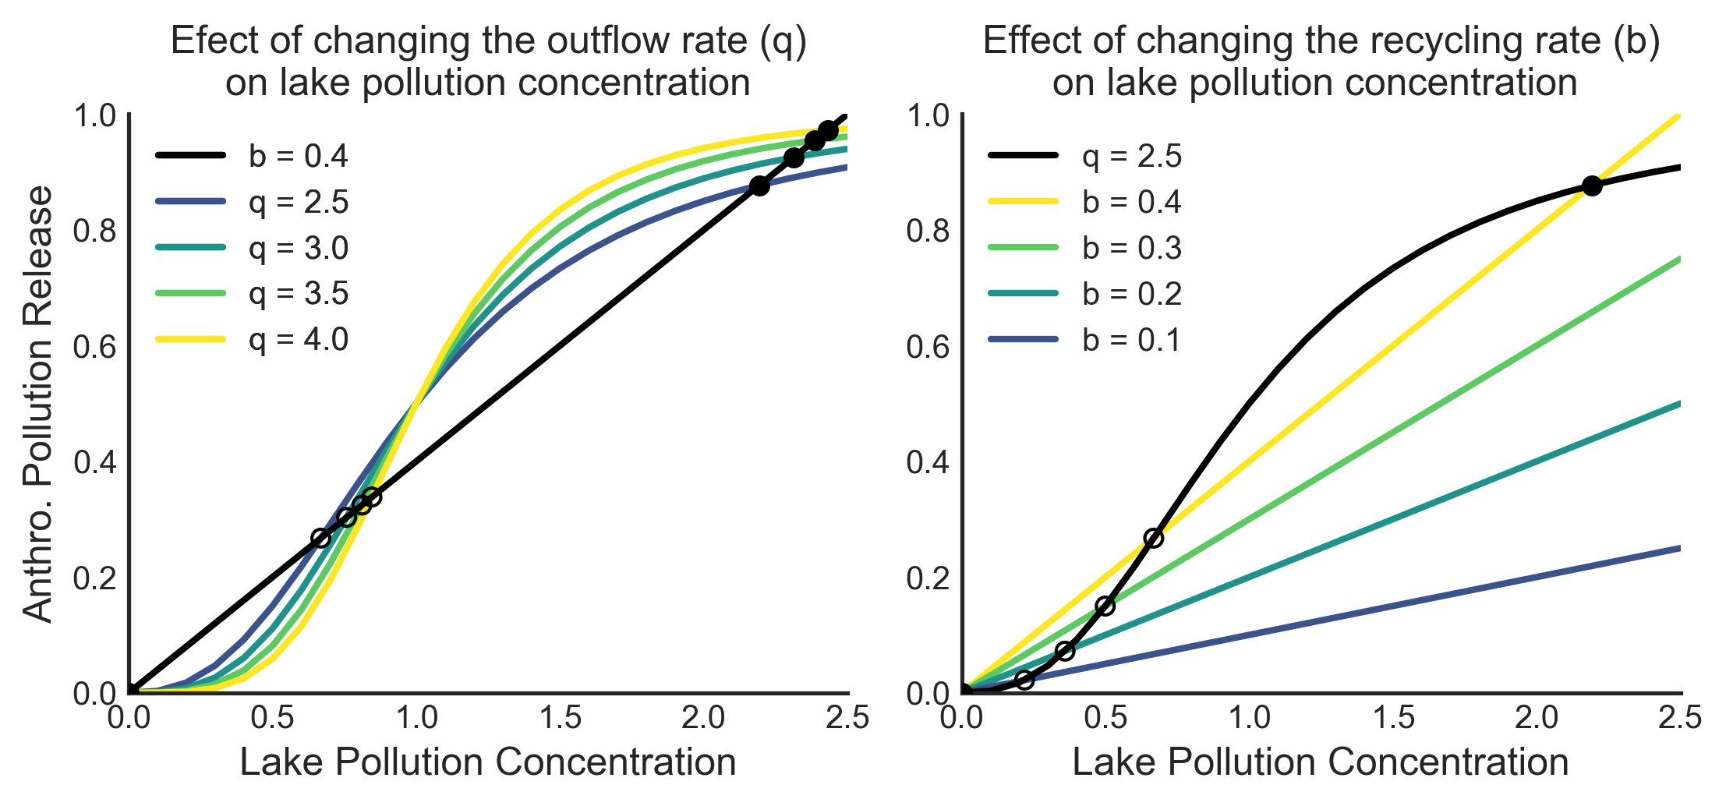
The Lake Problem
Quinn, J. D., P. M. Reed, and K. Keller. 2015. http://doi.org/10.1016/j.envsoft.2017.02.017
Notes:
Three bullets in order of visuals. 1 sentence summary for all three with references.

Slide 18
The Lake Problem
Policy Levers - Variable
System
Relations
Lake Recycling and Removal Rates
Pollution Release Variance
Utility Discount Factor
Pollution Level
Reliability
Utility
Inertia
Notes:
Three bullets in order of visuals. 1 sentence summary for all three with references.

Slide 19
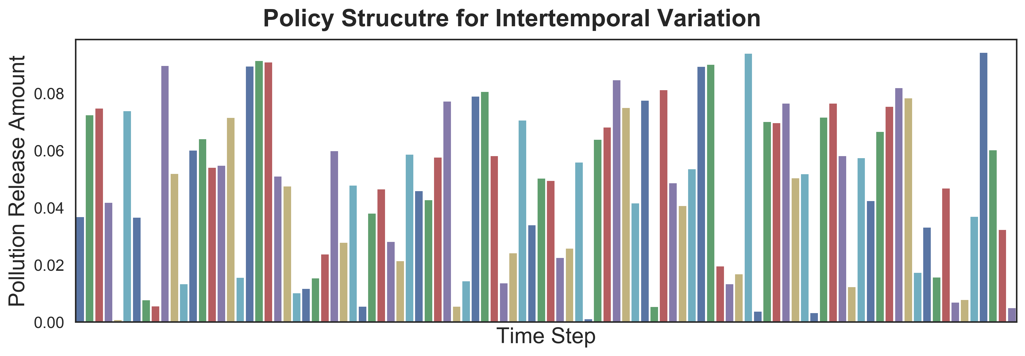
The Lake Problem: Variations
Intertemporal
Notes:
Three bullets in order of visuals. 1 sentence summary for all three with references.

Slide 20
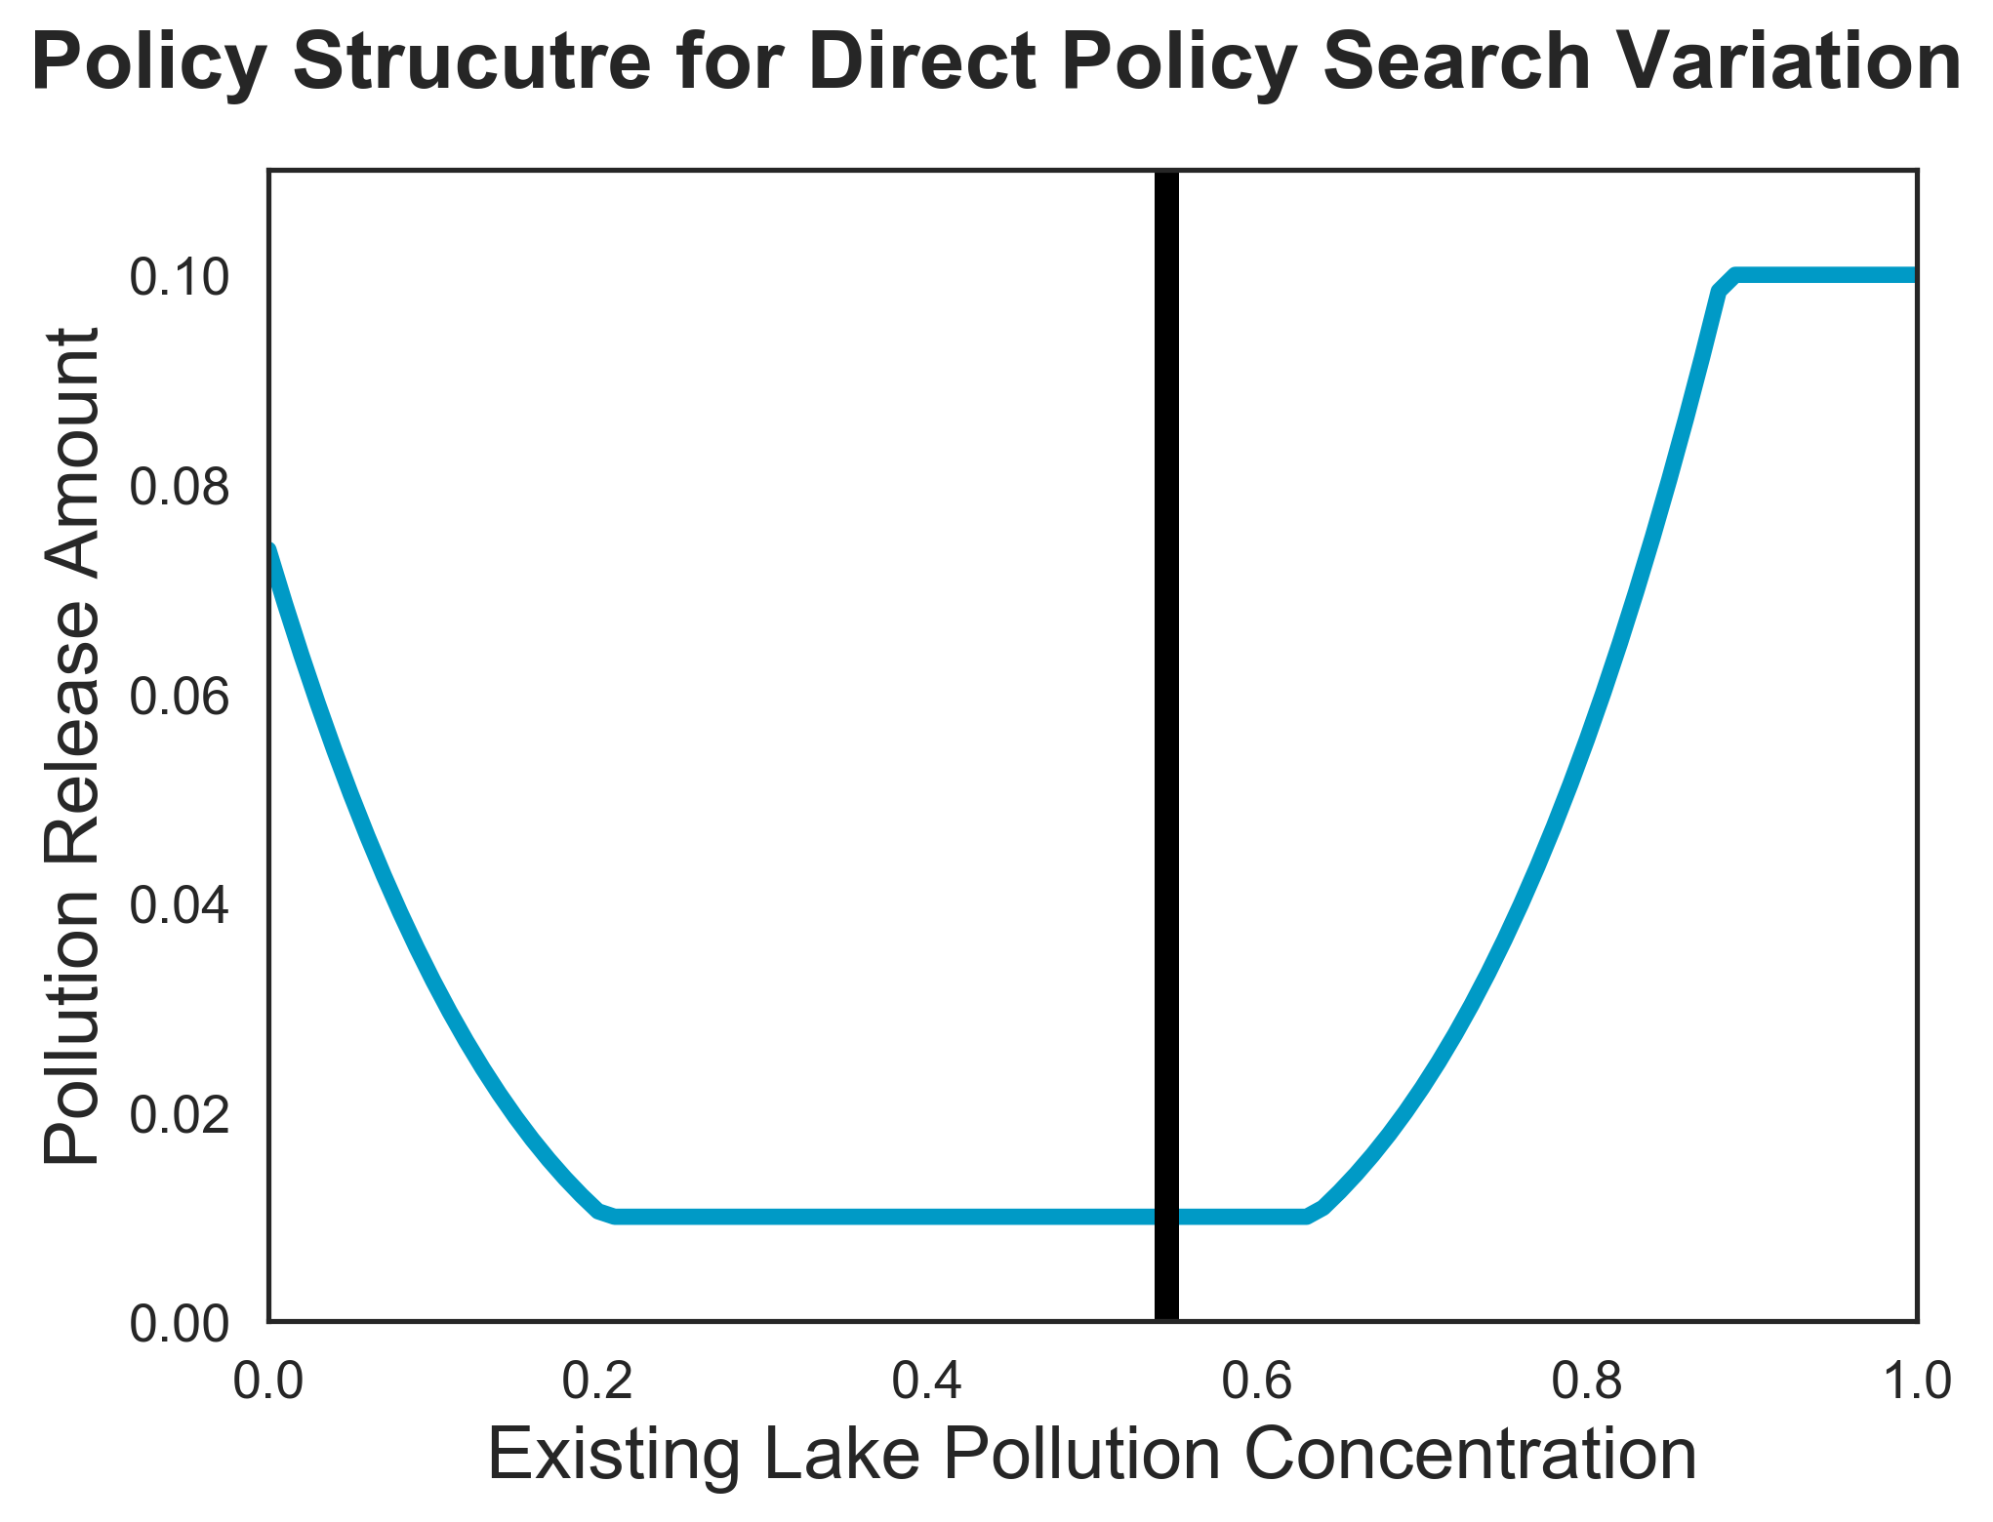
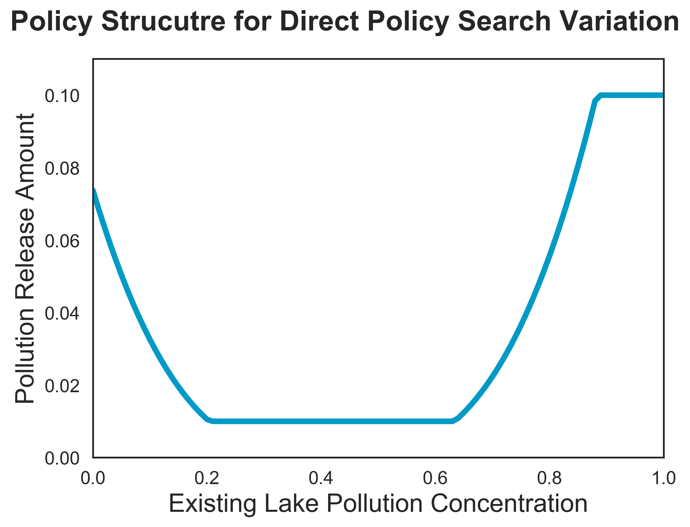
The Lake Problem: Variations
Direct Policy Search
Tipping Point

Slide 21
The Lake Problem: Variations
Planned Adaptive DPS: Proposed
DPS with decisions updated every 10 time steps
More closely mimics real-world policies
Parameterization based on Quinn et. al (2017)
Quinn, J. D., P. M. Reed, and K. Keller. 2015. http://doi.org/10.1016/j.envsoft.2017.02.017
Notes:
Three bullets in order of visuals. 1 sentence summary for all three with references.

Slide 22
Implementation Details
EMA Workbench – Optimization, Uncertainty Analysis, Scenario Discovery
Platypus – Auto-adaptive ε-NSGAII Hybrid MOEA (generational version of BORG)
Cython implementations of lake problems
Satisficing robustness based on Starr’s domain criterion and Singh et. al (2015)
Amazon AWS Compute Servers, Linux-based
Singh, R., P. M. Reed, and K. Keller. 2015. http://doi.org/10.5751/ES-07687-200312
Notes:
EMA Workbench – obvi
Platypus and the generational BORG – check out the code in EMA workbench for a description. Basically uses the same variators as BORG with configuration details based on BORG literature, and uses adaptive population sizing. Generational BORG is much easier to parallelize than steady-state BORG, as there is no dependency on previous generations.
Cython – runs so fast!
Satsficing robustness: basically looks for volume of scenarios for a policy that are above (if the criterion is set to minimize) or below (for maximize) the defined threshold. Results in a robustness value between 0 and 1 (abstracted from the original units of the outcome of interest). Domain criterion mechanism allows decision maker to be as conservative as they want to be.
Included the DOI in small text at the bottom of the slide, but can be removed if it feels too cluttered.

Slide 23
Points of Comparison
Method and Model Setup Requirements
Communication
Access to results during method execution
Effect of updating method and model
Results
Computational cost
Overall robustness

Slide 24
Computational Cost

Slide 25
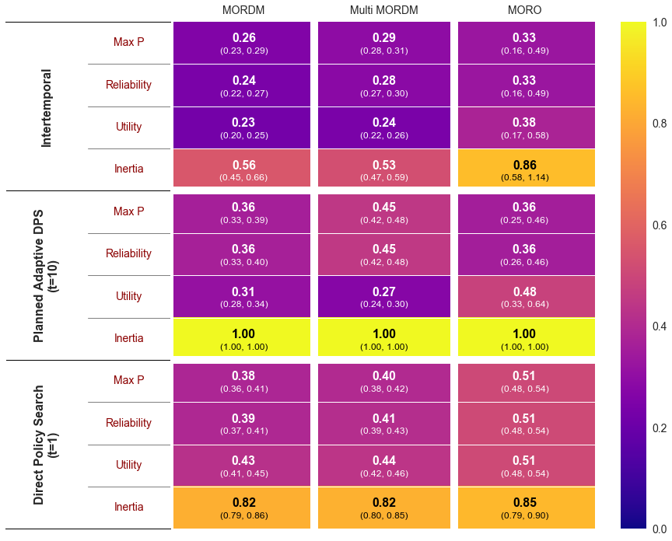



Mean Robustness across Methods
Notes:
Animated, with versions. Changes on click
Base is just the row and column names
Column names (methods) are in red
Row group names (models) are in red
Row outcome names (outcomes of interest) are in red
Add colorbar (not sure if this one is entirely necessary)
Whole heatmap
Planned adaptive row only
The moral of this slide is that it summarizes everything. In general, the trend is that the more you include robustness consideration in the search phase of a framework, the more robust the policies will be that are identified.
The surprising result is the sharp increase in robustness related to maximum pollution in the lake and reliability, while at the same time a decrease in utility (this is where you can zoom into the step 7.

Slide 26
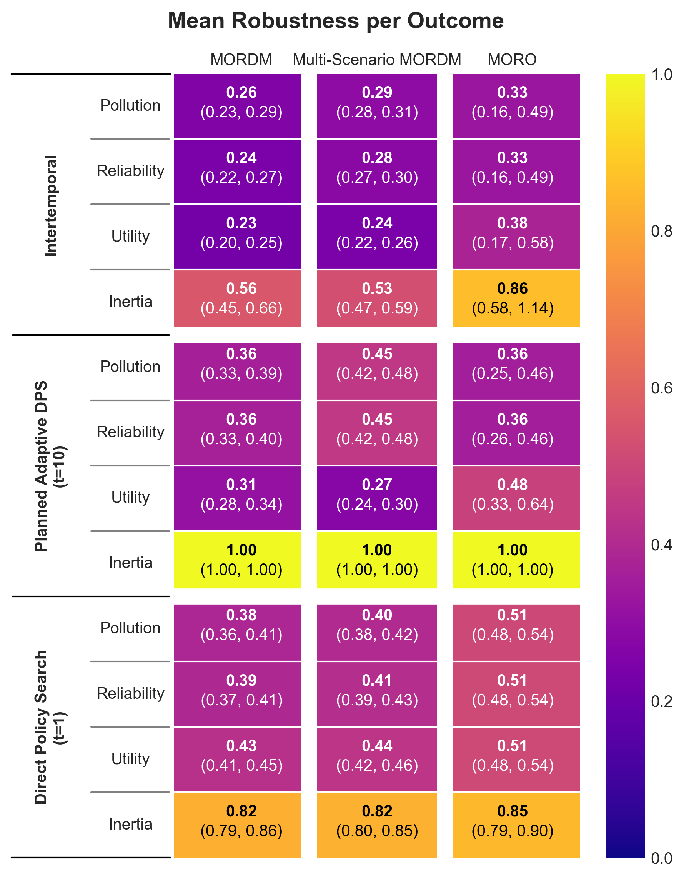
Mean Robustness across Methods
Notes:
Animated, with versions. Changes on click
Base is just the row and column names
Column names (methods) are in red
Row group names (models) are in red
Row outcome names (outcomes of interest) are in red
Add colorbar (not sure if this one is entirely necessary)
Whole heatmap
Planned adaptive row only
The moral of this slide is that it summarizes everything. In general, the trend is that the more you include robustness consideration in the search phase of a framework, the more robust the policies will be that are identified.
The surprising result is the sharp increase in robustness related to maximum pollution in the lake and reliability, while at the same time a decrease in utility (this is where you can zoom into the step 7.

Slide 27
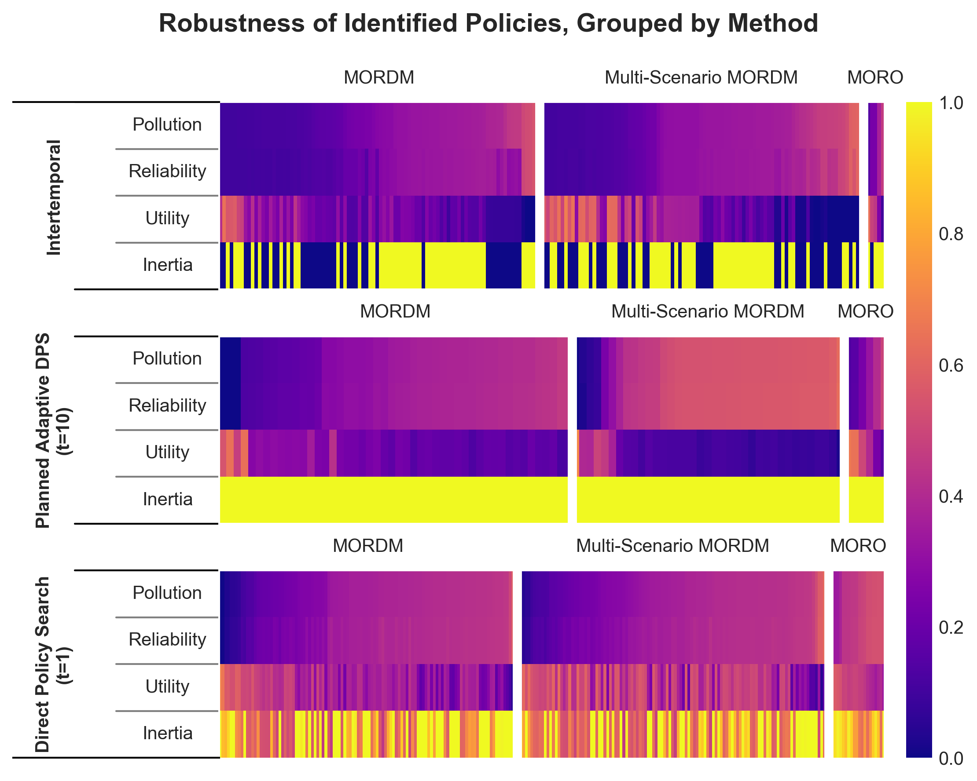
Per Policy Robustness for Planned Adaptive DPS
MORDM
Multi-Scenario MORDM
MORO
Notes:
MORDM and MORO both reveal a wide range of robustness values and demonstrate nicely policy options that indicate the tradeoff between reliability and utility.
Multi-MORDM moves very quickly to conservative approaches that prioritize reliability and low maximum pollution and sacrifice utility.
This is what leads to the spike in robustness for maxp and reliability, as well as the decrease in utility that was shown on the previous slide. Let’s investigate this more…

Slide 28
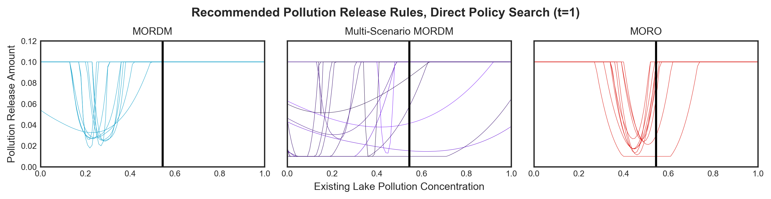
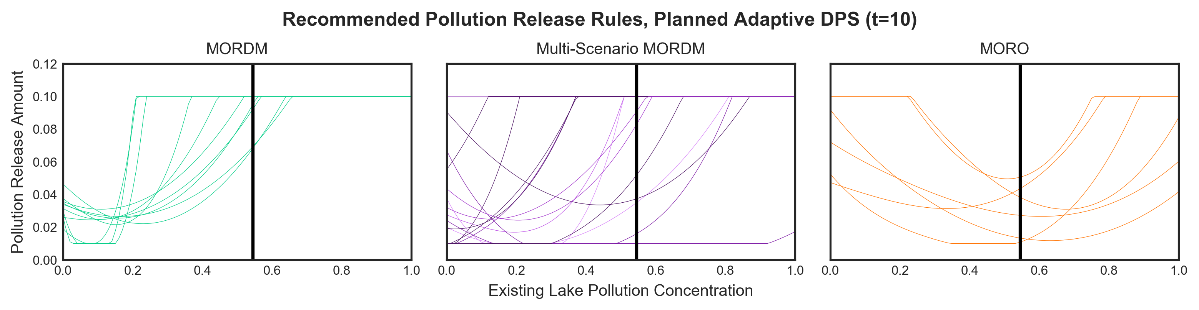
Anthropogenic Pollution Release Rules
Direct Policy Search
Planned Adaptive DPS
Notes:
Anthropogenic pollution release rules. Alternative to the release patterns on the slide showing decisions over time. The black line is the critical P ratio, the tipping point of the problem
Slide is animated to first show DPS only, then show planned adaptive DPS, then show both together.
What is shown: planned adaptive rules are in general more conservative, as the anthropogenic release drops earlier and stays low for longer on average.

Slide 29
Conclusions
The more you include robustness in the search phase, the more robust your policy alternatives will be
Reference scenario selection can have a massive impact on the characteristics of recommended policies
Impact seems to be larger when policies adapt more slowly
Notes:
It seems like problems that support fast adaption are less affected by reference scenario selection than policies with slower adaptation. This is obviously not 100% known, but in this case, with this model and these policy formats, it seems like that is what is happening.
In future:
need to look into the impact of varying numbers and types of scenario selection for the search phase of MORO (how many do you need before you start getting to a point of diminishing returns)
Different decision period for the planned adaptive model (5, 20, etc.)
More about the scenario selection process for multi-mordm: how do different methods affect the results – with the goal of being able to select the best method based on stakeholder goals
Comparison of NSGAII hybrid to other methods of MOEA, including BORG.

Slide 30
The Bigger Picture
Structured and broad comparative framework
Analysts: consider effect of policy structures on a method and effectiveness of methods
Decision Makers: highlight impact of method selection on results of analysis

Slide 31
Reflections
Results are likely specific to a problem specification
Need to compare multiple problems to develop solid generalizations

Slide 32

Thank You
eebart/RobustDecisionSupportComparison
Questions?

Slide 34
Notes:
Animated, with versions. Changes on click
Base is just the row and column names
Column names (methods) are in red
Row group names (models) are in red
Row outcome names (outcomes of interest) are in red
Add colorbar (not sure if this one is entirely necessary)
Whole heatmap
Planned adaptive row only
The moral of this slide is that it summarizes everything. In general, the trend is that the more you include robustness consideration in the search phase of a framework, the more robust the policies will be that are identified.
The surprising result is the sharp increase in robustness related to maximum pollution in the lake and reliability, while at the same time a decrease in utility (this is where you can zoom into the step 7.

Slide 35
Mean Robustness for the Planned Adaptive DPS variation

Slide 36
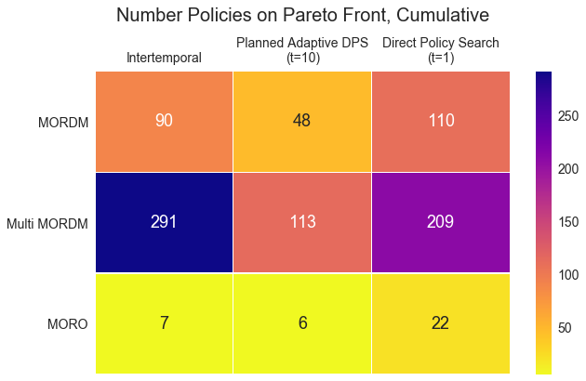
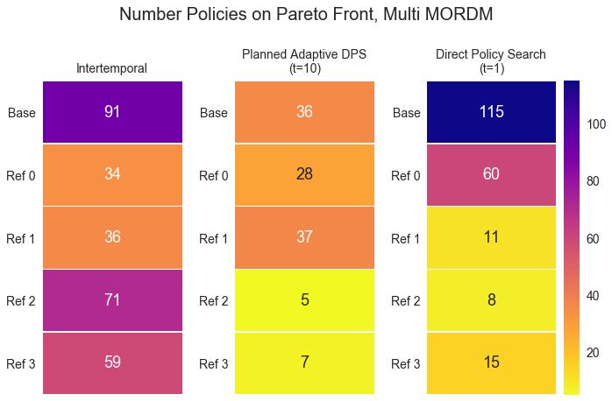
Pareto Front Size Comparison
Notes:
Probably not in scope for this presentation, but shows the Pareto front size across model+method pairings. Just indicates the number of polices that are presented, not anything else like diversity of lever values or the like. l

Slide 37
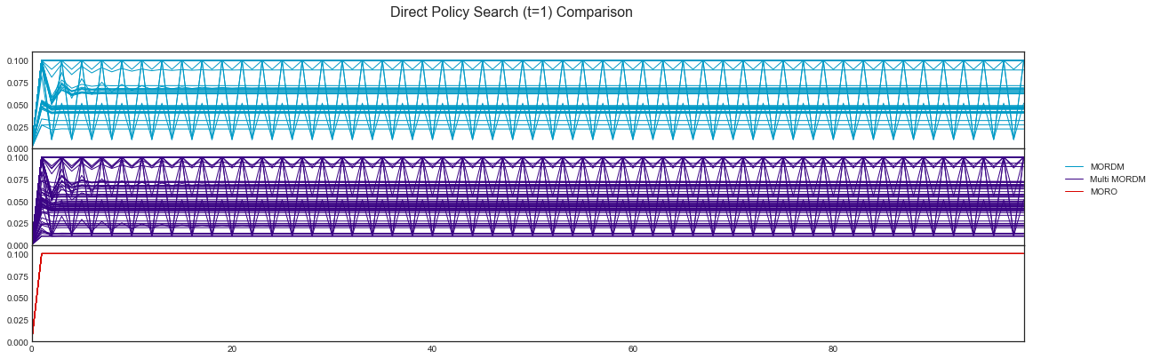
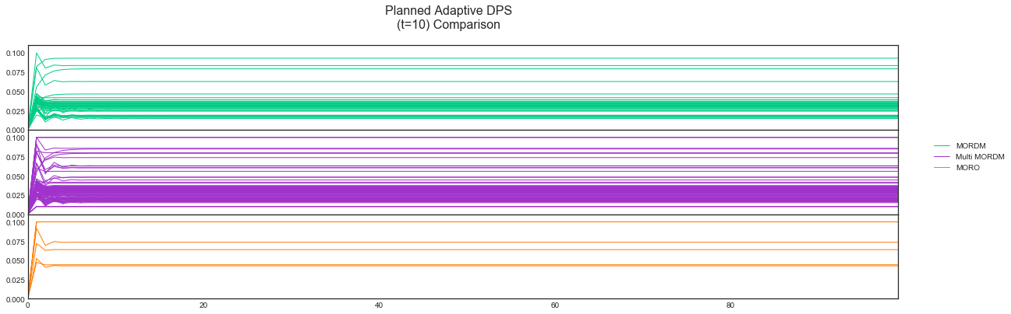
Anthropogenic Pollution Trends
MORDM
DPS, t=1
Multi-Scenario MORDM
MORO
MORDM
Planned Adaptive DPS, t=10
Multi-Scenario MORDM
MORO
Notes:
Planned adaptive settles on a release level pretty quickly, while dps is able to bounce back and forth between levels more responsively due to the updating of pollution release every timestep.

